Slide 1
Low-fi Prototype
Pilot Usability Test
Site Manager
Joseph Koop
Kelvin Gordon
Enrique Garcia
Human Computer Interface

Slide 2
Design Sequence
Step 1
Step 2
Step 3
Step 4
Step 5
Create 5 interface designs on paper for various device types (3 images each)
Choose 2 to create in more detail, showing interaction between screens (3 images each)
Choose 1 to create the prototype from
Create storyboards for all 3 tasks based on the chosen design
Test the prototype with users by making them complete the tasks; log issues.
Confidential

Slide 3
Mission Statement
Construction companies need a digital dashboard to track all projects, employees, and equipment in one place because current systems lack real-time visibility and lead to inefficiencies.
Our solution is to create a live map that links to projects and shows exactly which employees, equipment, and materials are needed at each location.
Confidential

Slide 4
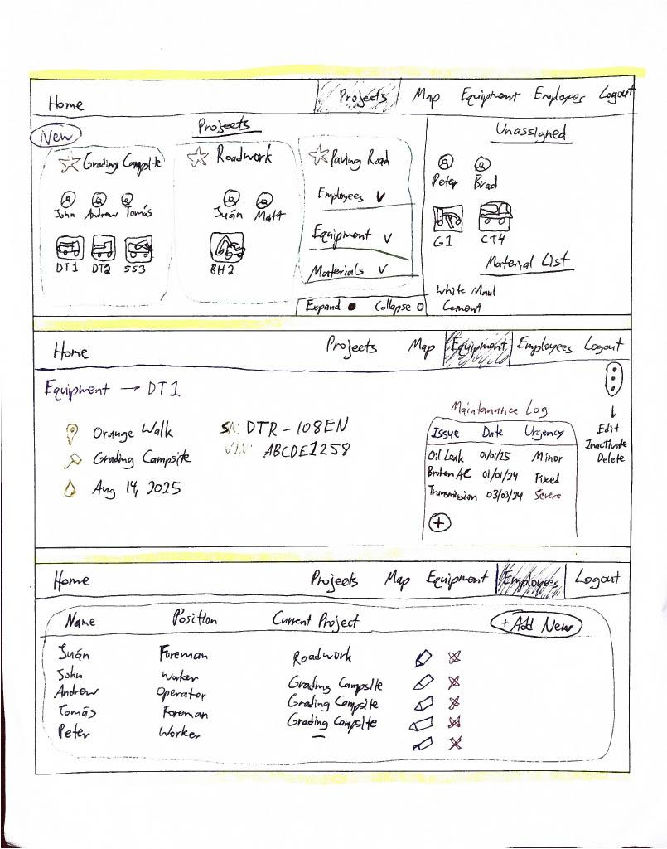
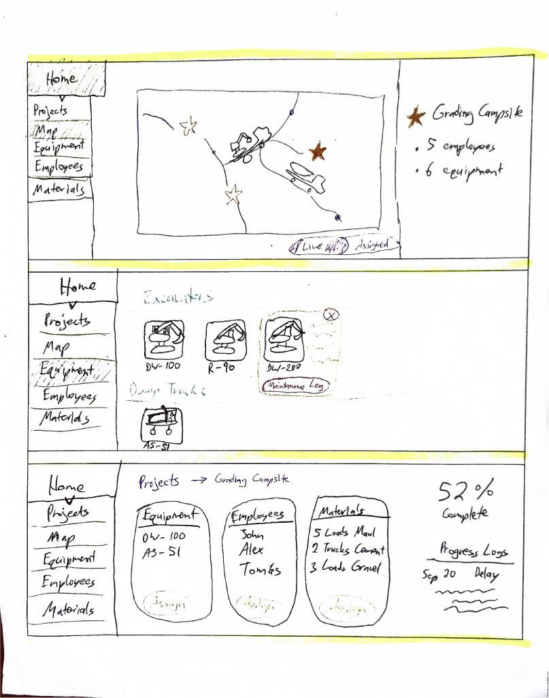
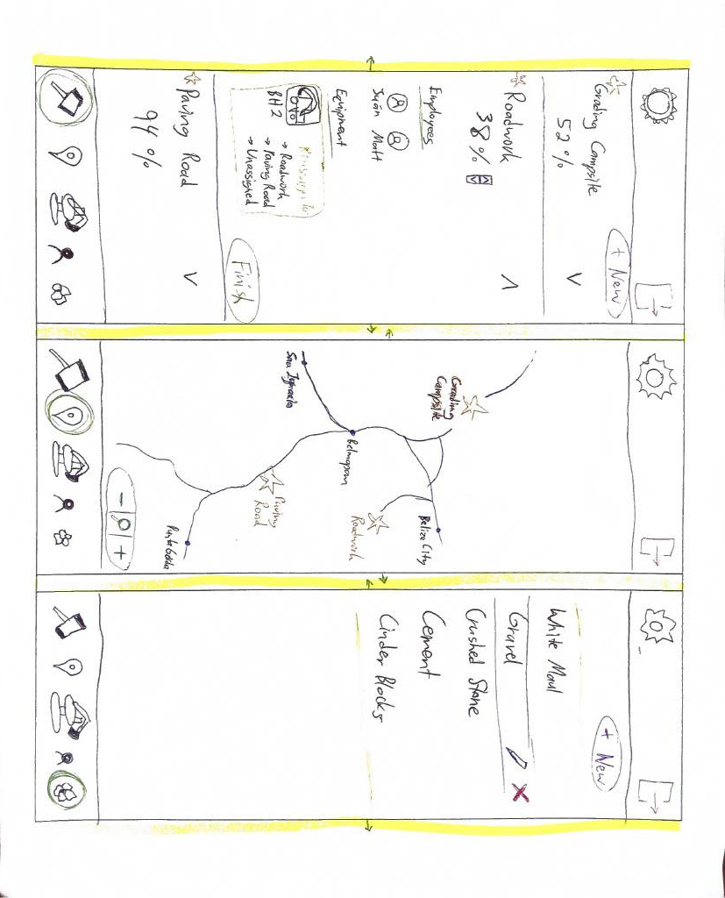
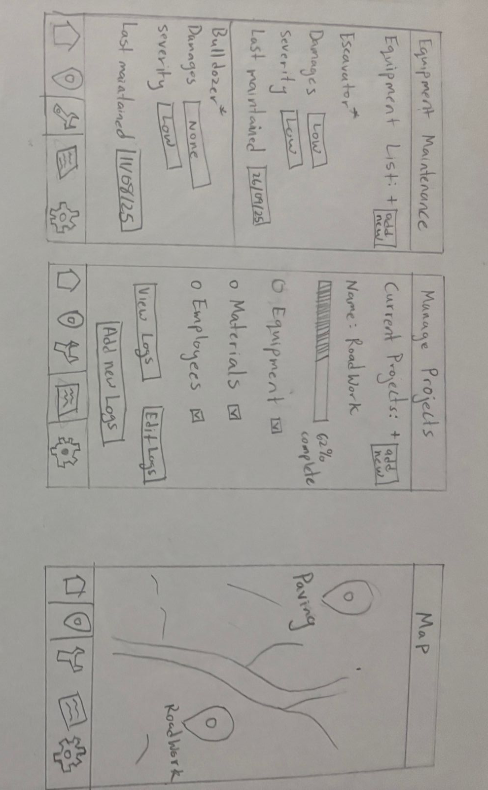
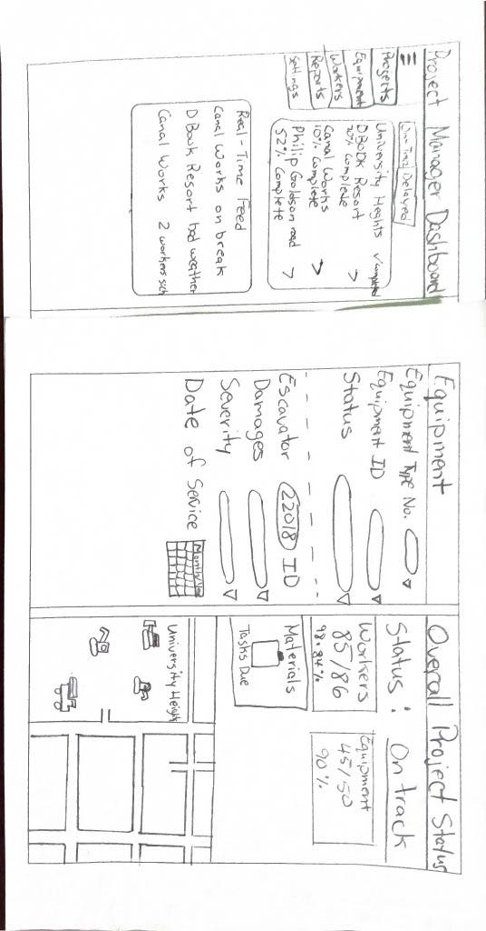
Interface Designs
Web #1
Web #2
Mobile #1
Mobile #2
Tablet #1
Confidential

Slide 5
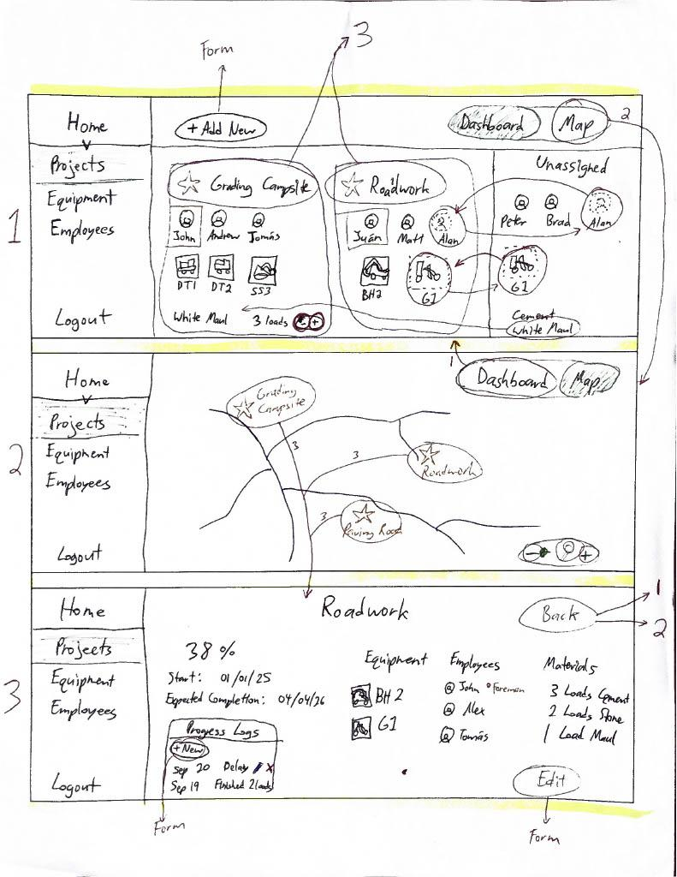
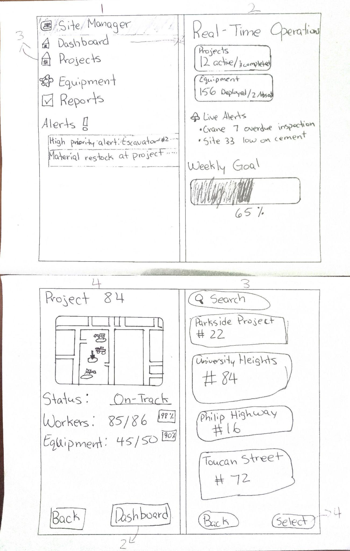
Finalists
#1
#2
Created from Web #1 and #2
Created from Mobile #1 and #2 and Tablet #1
Confidential

Slide 6
Comparison
#1 Strengths | #2 Strengths
Web based | Mobile based
Simple navigation | More alerts/feedback
More workable | More simplistic
Confidential

Slide 7
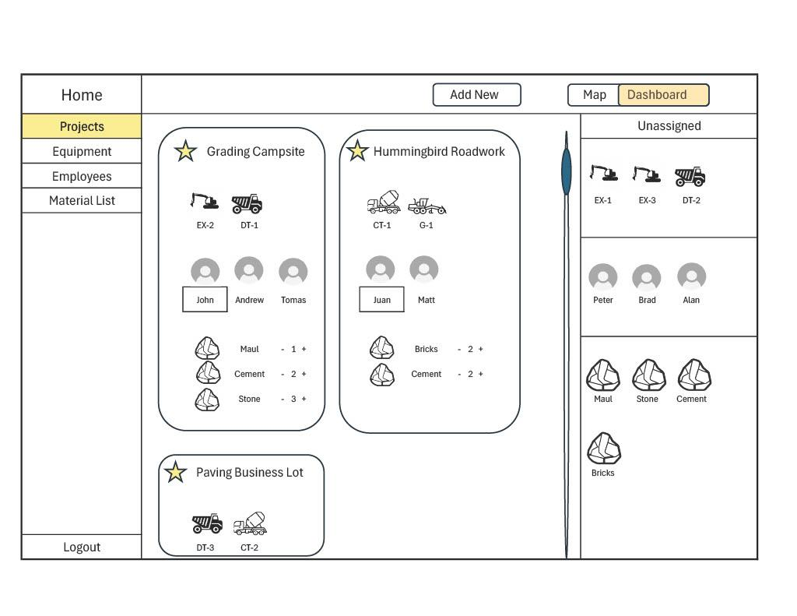
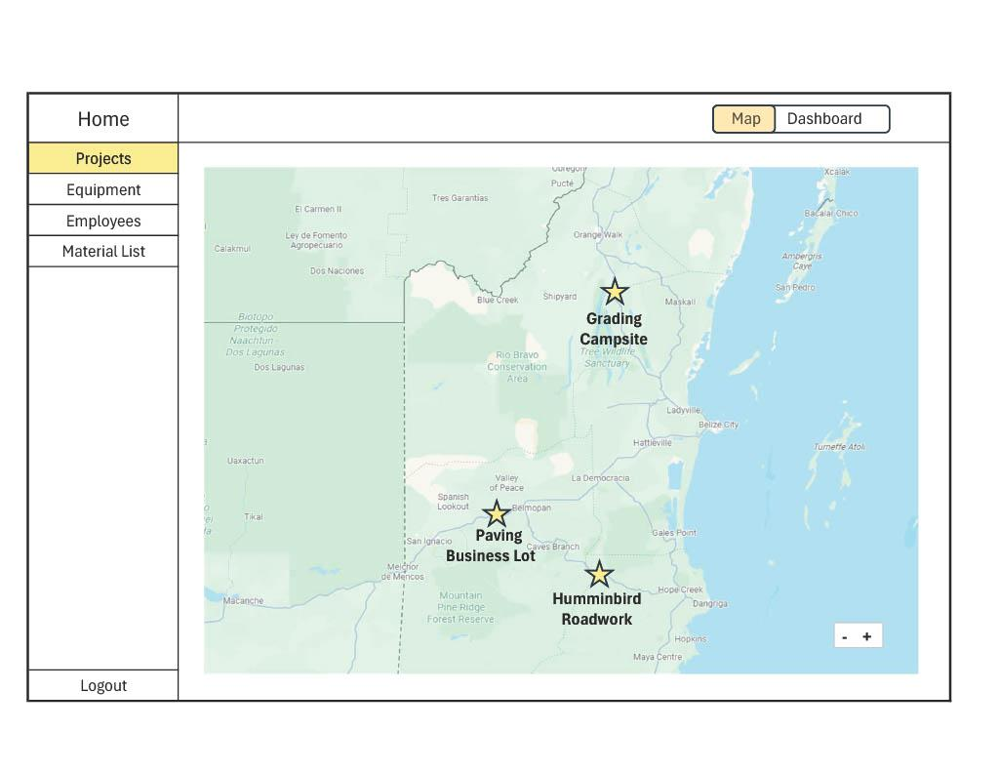
Prototype
Confidential

Slide 8
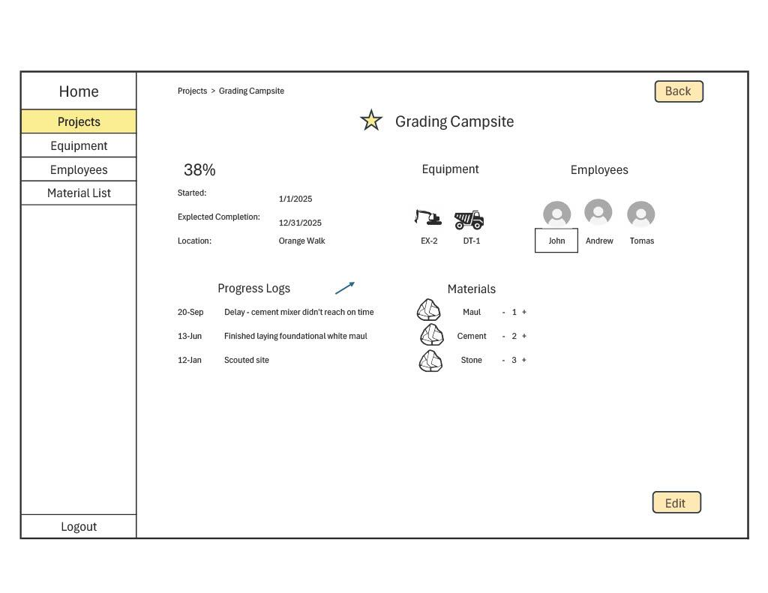
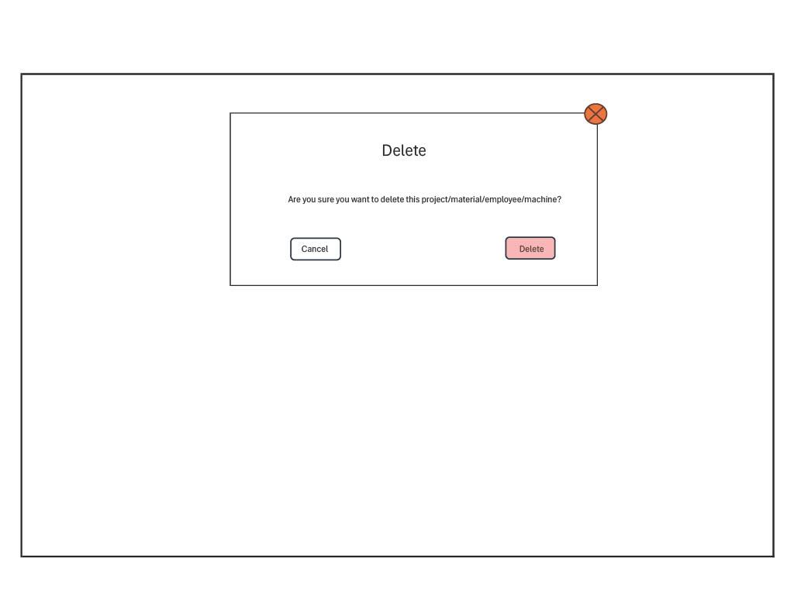
Prototype
Confidential

Slide 9
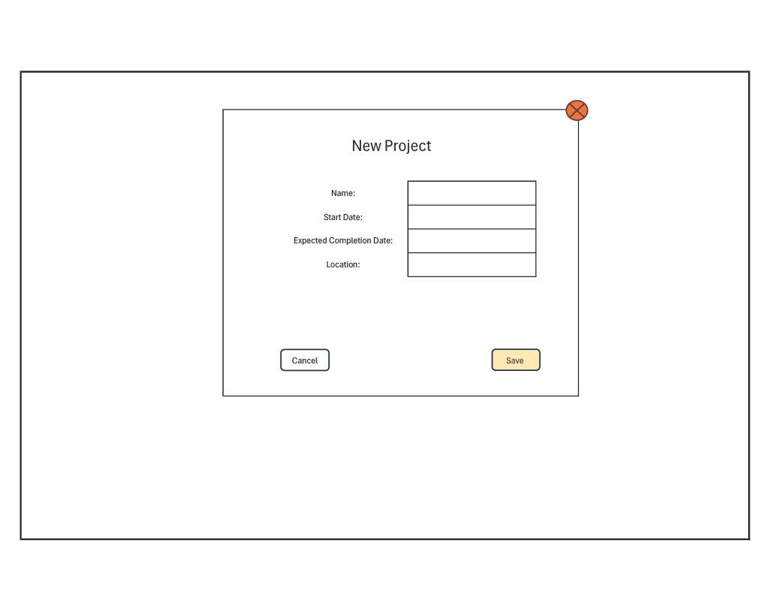
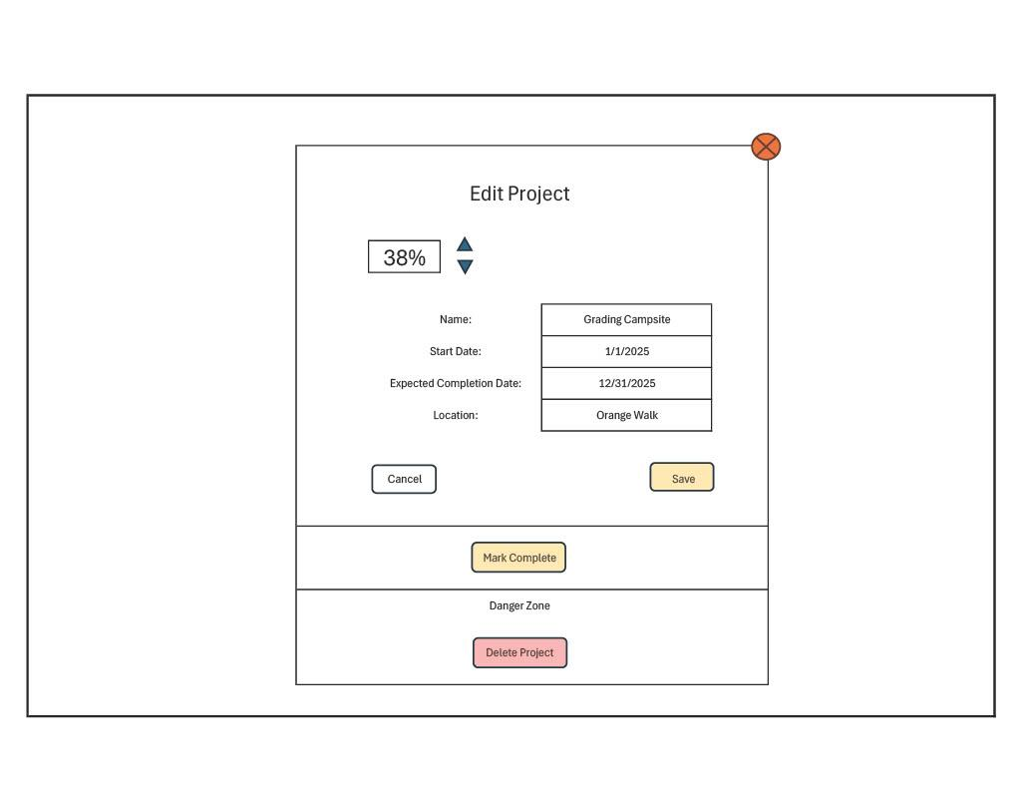
Prototype
Confidential

Slide 10
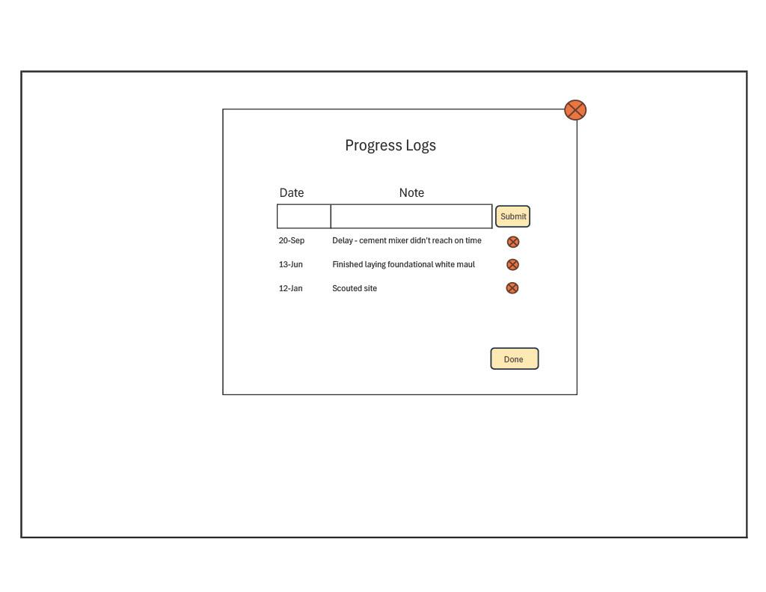
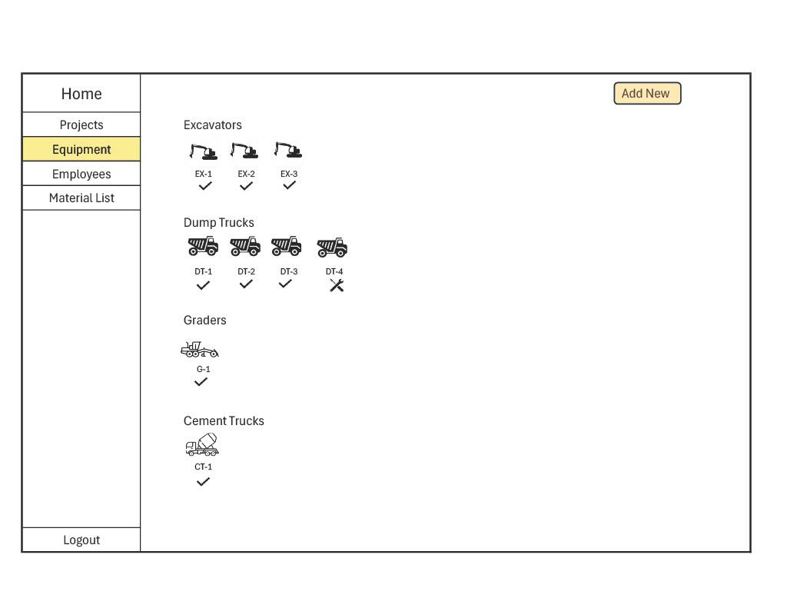
Prototype
Confidential

Slide 11
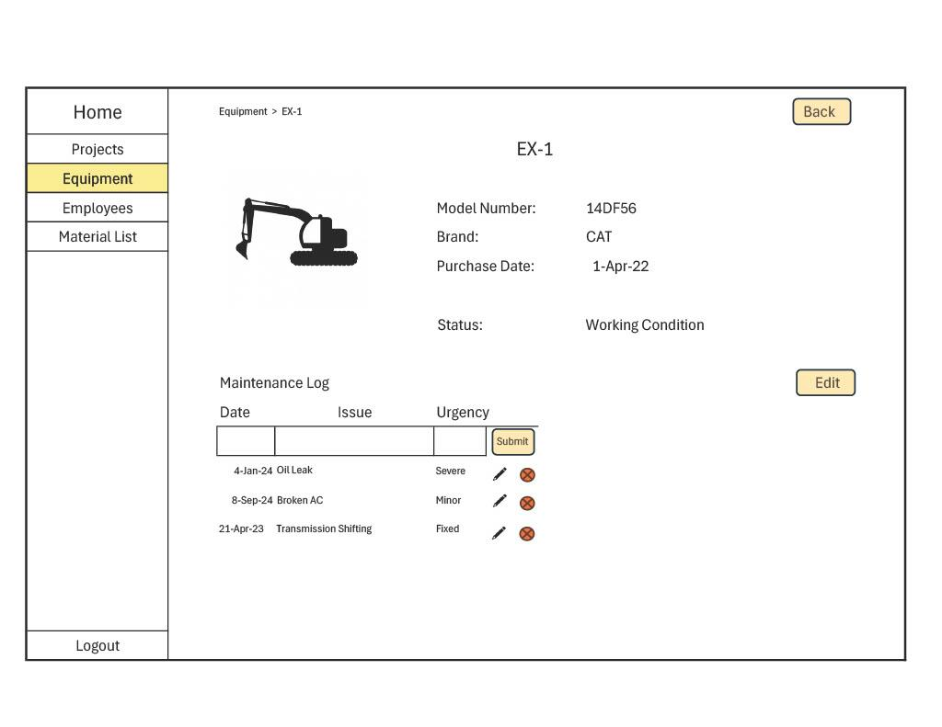
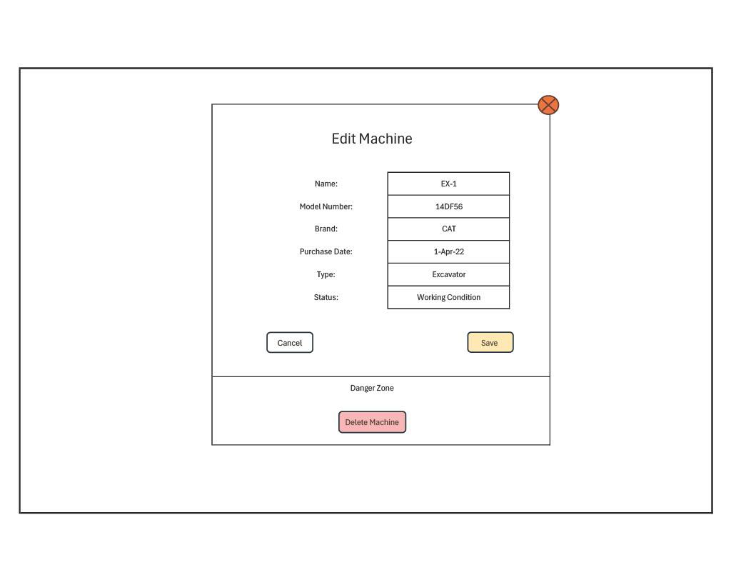
Prototype
Confidential

Slide 12
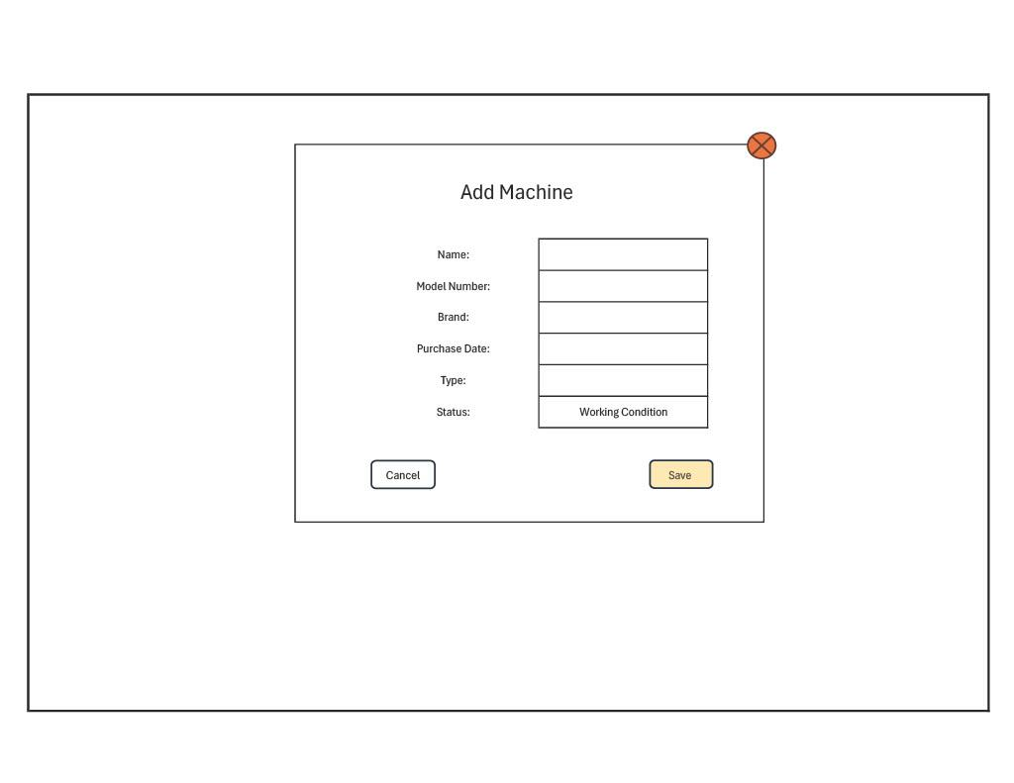
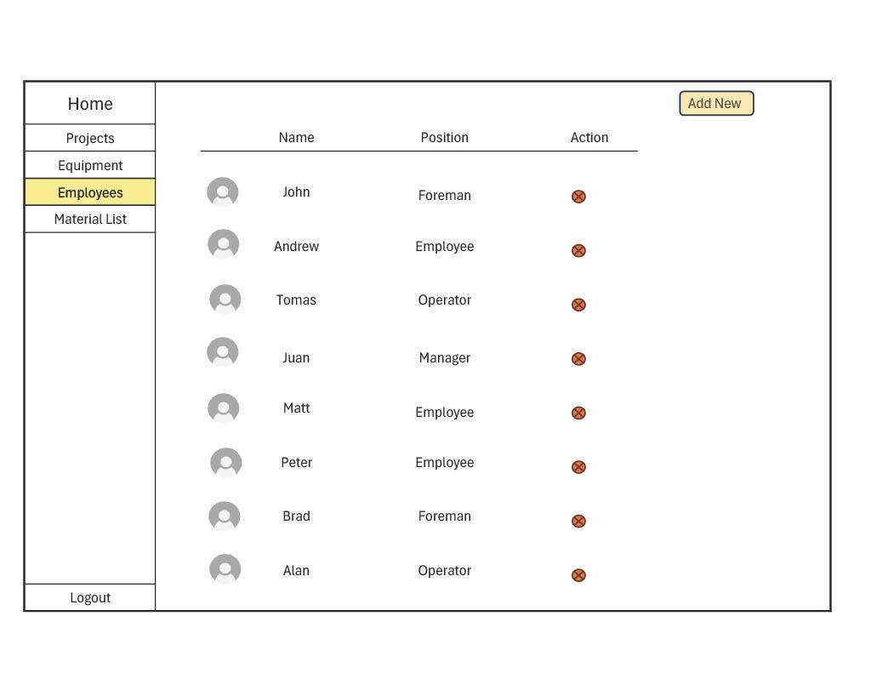
Prototype
Confidential

Slide 13
Prototype
Confidential

Slide 14
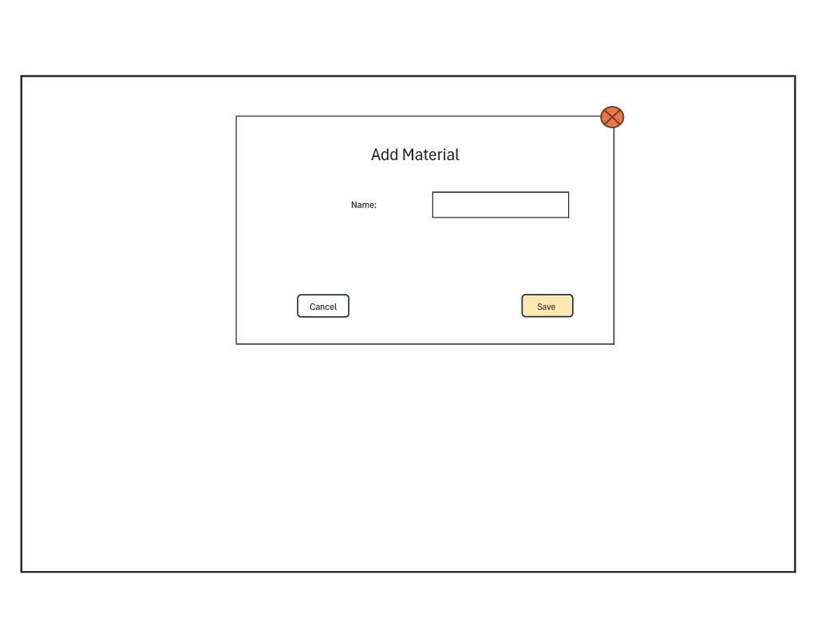
Prototype
Confidential

Slide 15
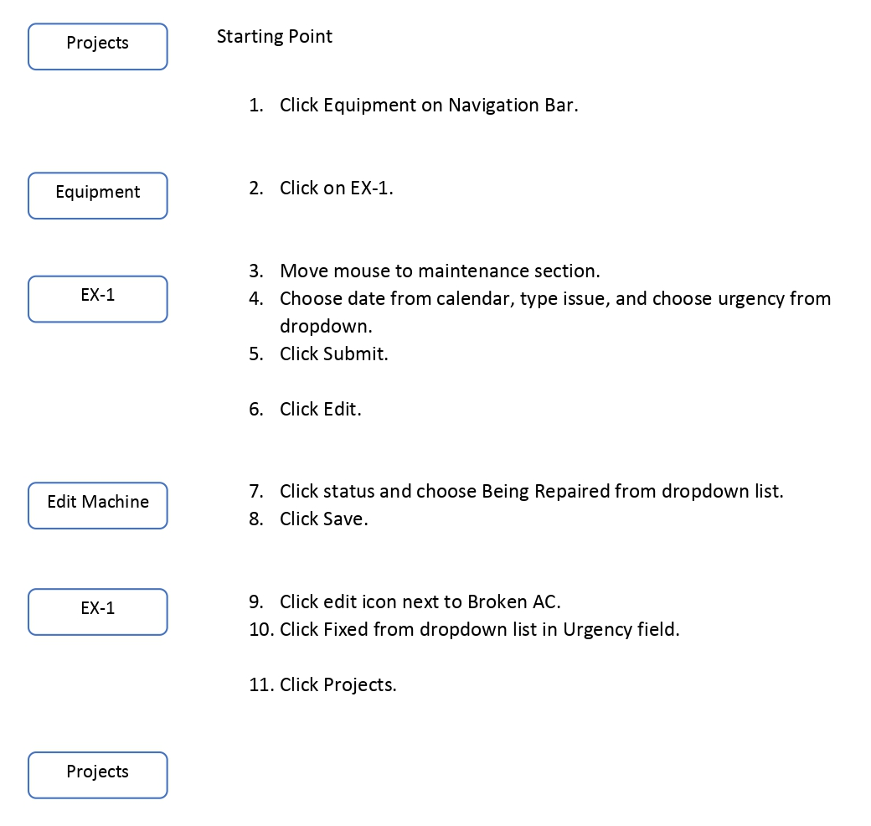
UI Task Flows - Easy
Task Description:
Add a new maintenance log to the excavator EX-1: May 3, 2025, Busted Hydraulic Hose, Severe.
Change the status of the machine from Working Condition to Being Repaired.
Mark the Broken AC log as being fixed.
Return to projects page.
Confidential

Slide 16
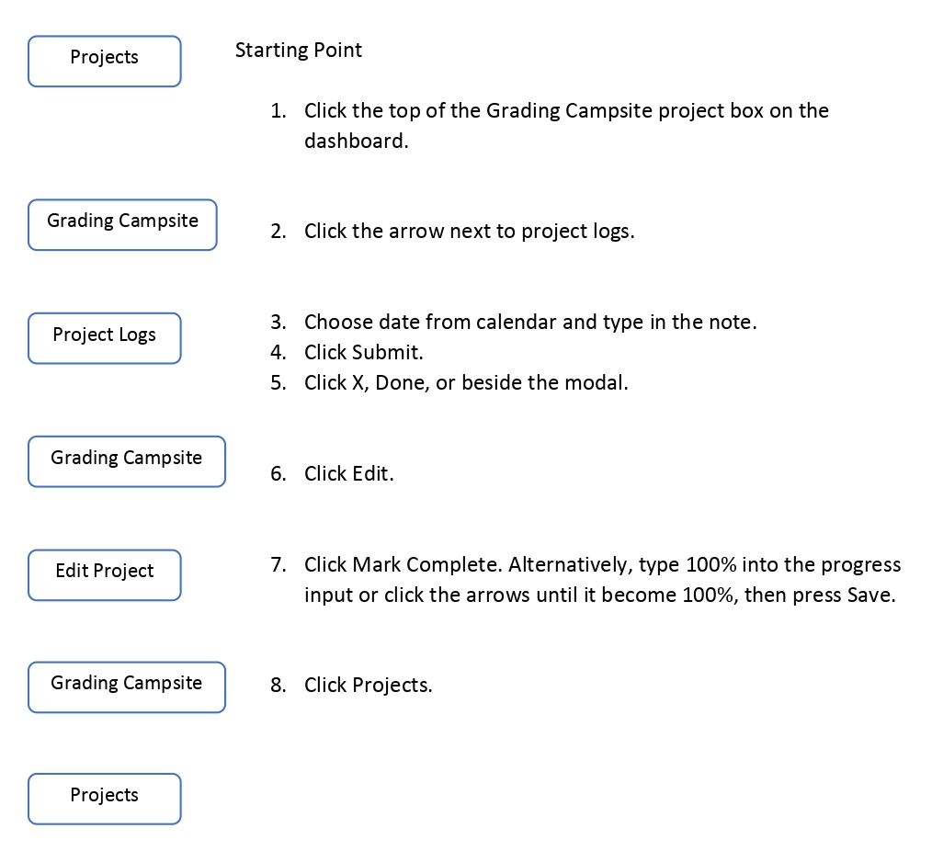
UI Task Flows - Medium
Task Description:
Add a new progress note to Grading Campsite specifying that project was completed on December 24, 2025.
Mark the project as Complete.
Return to projects.
Confidential

Slide 17
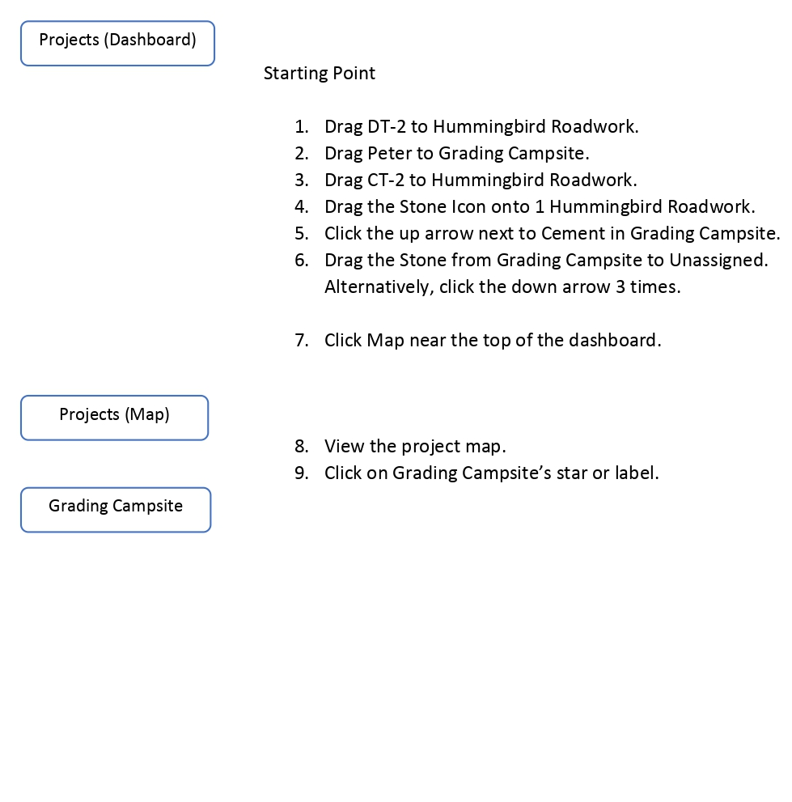
UI Task Flows - Hard
Task Description:
Assign DT-2 to Hummingbird Roadwork.
Assign Peter to Grading Campsite.
Reassign CT-2 to Hummingbird Roadwork.
Add 1 load of Stone to Hummingbird Roadwork.
Change the loads of Cement from 2 to 3 in Grading Campsite.
Remove the load of Stone from Grading Campsite.
Unassign Tomas.
Look at the overview of your projects on the map, then go to Grading Campsite to see more details.
Confidential

Slide 18
User Testing
Method
Execution
Roles
Found students in computer lab and asked them if they wanted to help us test
Introduced the system, gave them the tasks, then let them move around the interface until they figured out the task
Schedule conflicts
Facilitator + Computer: Joseph Koop
Observer + Notetaker: Enrique Garcia
Confidential

Slide 19
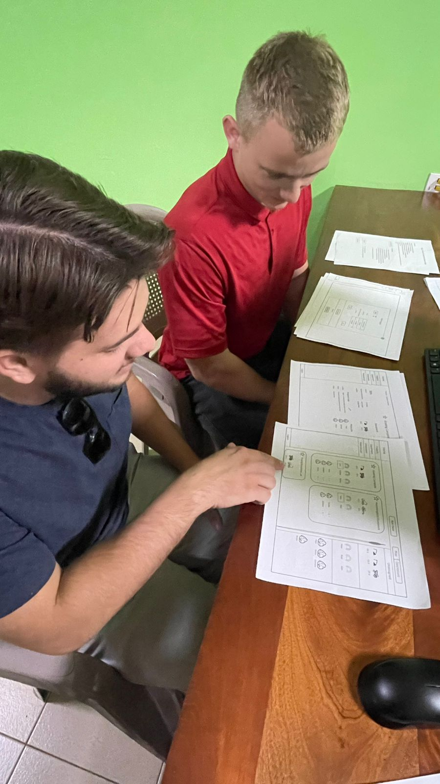
Test #1
Vibe: Understandable
Statements:
“Generally, once everything is color-coded, it will be pretty easy to follow.”
“You could box items so it's easier to follow.”
“Overall pretty simple”
Confidential

Slide 20
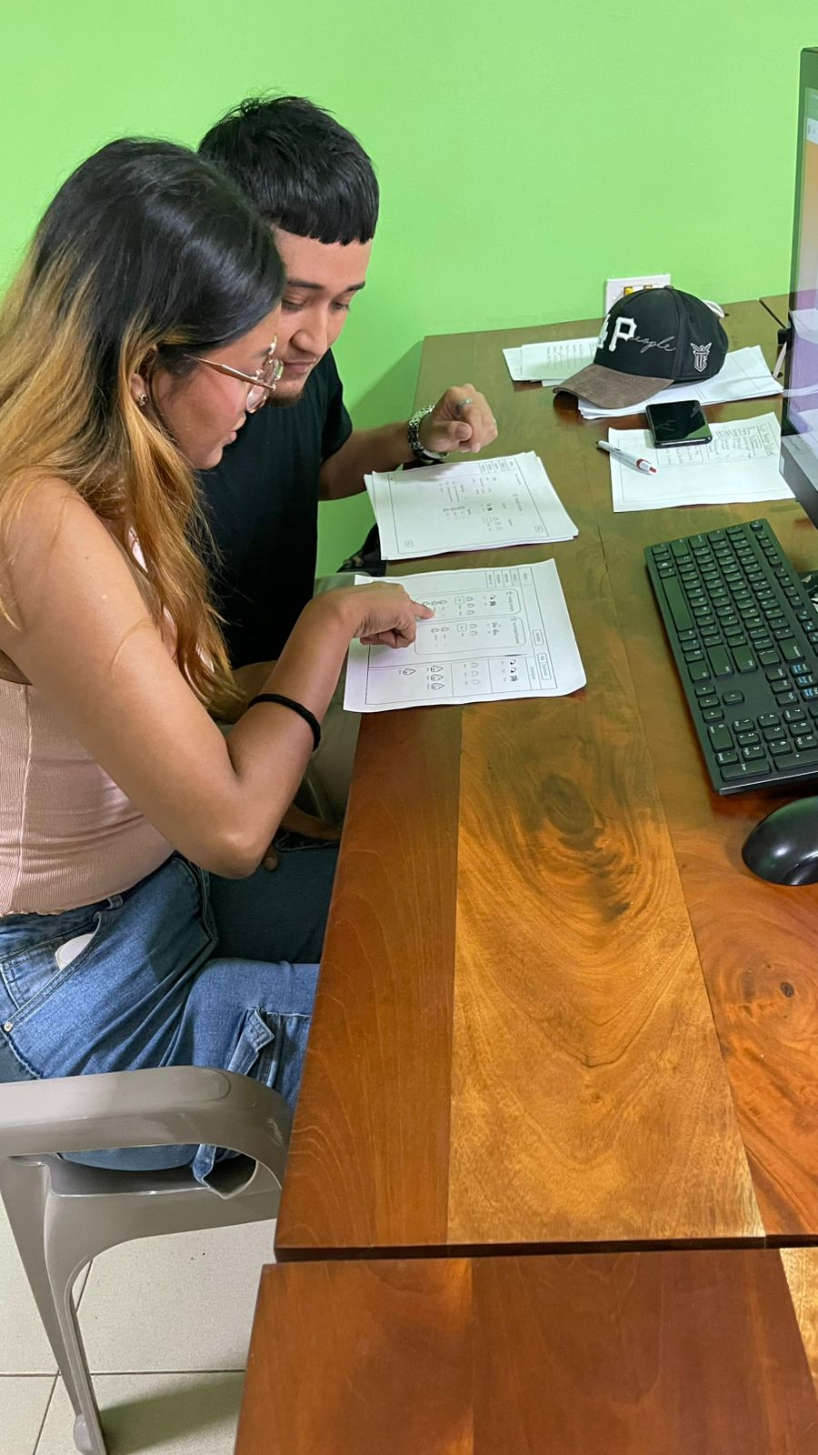
Test #2
Vibe: Enjoyable
Statement: “This is kind of fun”
Trouble Areas:
Not all icons directly linked to their individual page
Progress Notes link was not clear enough
Dragging to reassign took a while to figure out
Confidential

Slide 21
Conclusion
We gave the constraints of the system (what was possible/what was not)
Both users frequently visited the wrong sections, but were able to backtrack and figure out the tasks on their own
Some issues would be resolved with a more detailed UI
Confidential

Slide 22
Discovered UI Improvements
Color-code website
Enclose more elements in visible containers
More detailed features like drop-down arrows
Make certain links more perceivable (link to progress logs)
Make drag feature more intuitive
Use different method of assigning materials (list all under each project)
Confidential

Slide 23
The End
Confidential

